Slide 1

$ℓ_{p}$-Box ADMM: A Versatile Framework for Integer Programming
Baoyuan Wu
Senior Research Scientist, Tencent AI Lab
wubaoyuan1987@gmail.com
Baoyuan Wu* and Bernard Ghanem*, “Lp-Box ADMM: A Versatile Framework for Integer Programming”, TPAMI 2018

Slide 2
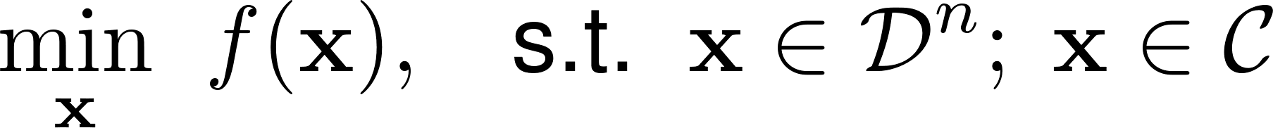
Integer Programming: Optimization

Slide 3
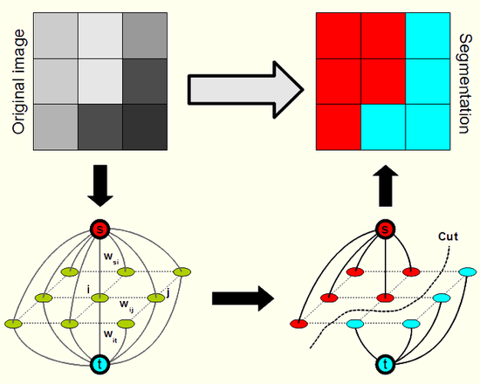
Integer Programming: Motivation
Many applications:

Slide 4
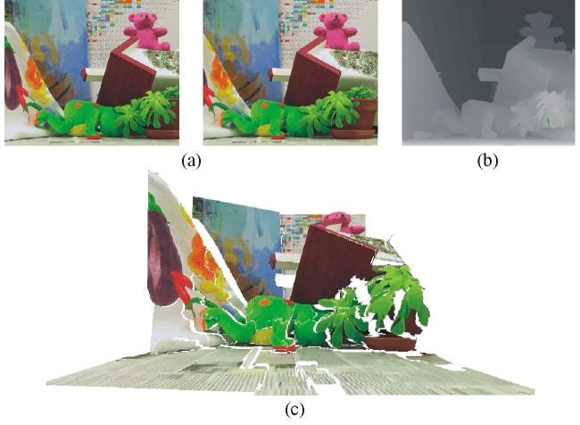
Integer Programming: Motivation
Many applications:
left image
right image
disparity/depth
3D

Slide 5
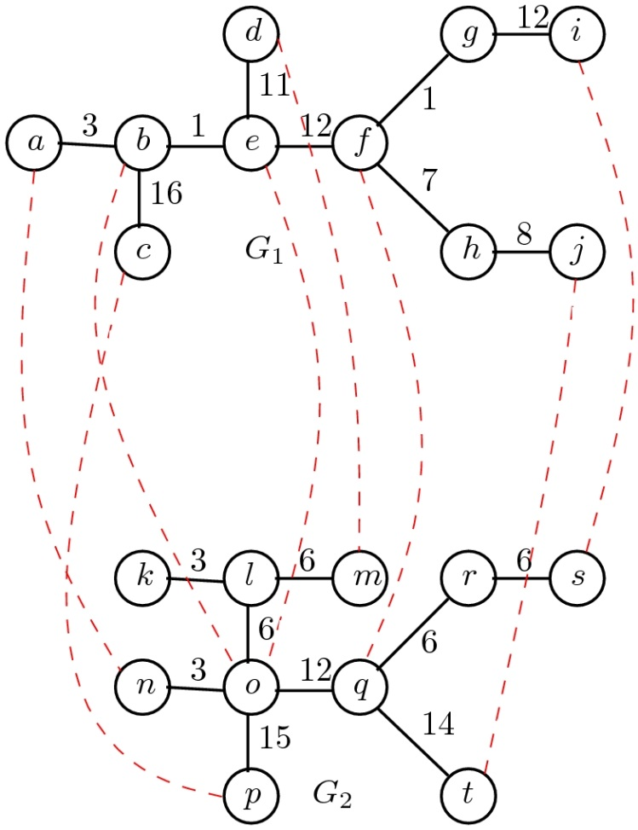
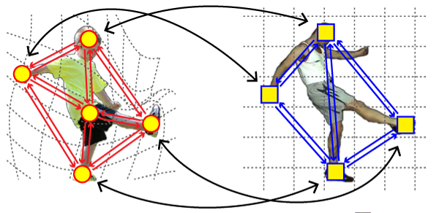
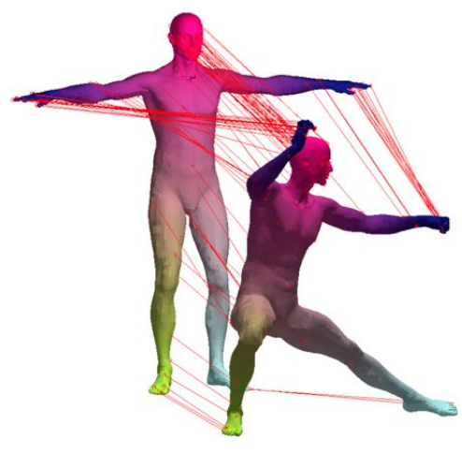
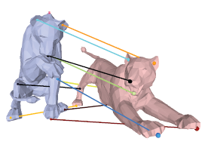
Integer Programming: Motivation
Many applications:

Slide 6
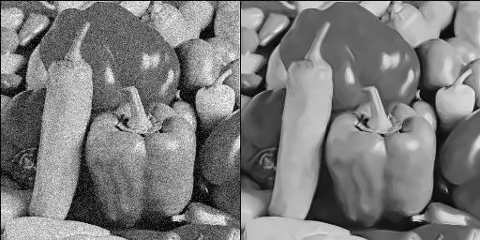
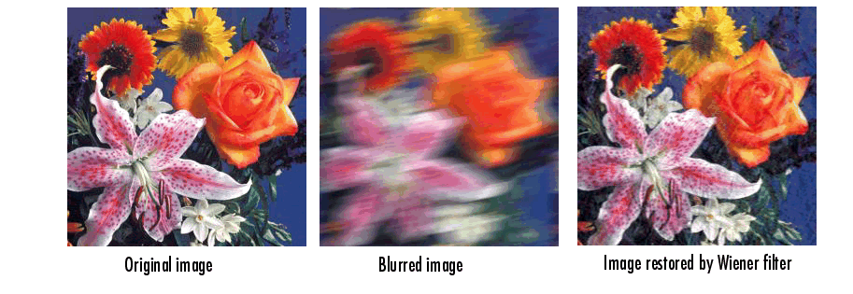
Integer Programming: Motivation
Many applications:
noisy image
denoised image
blurry image
deblurred image

Slide 7
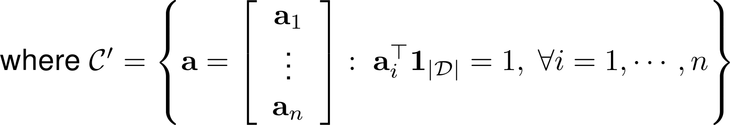
Integer and Binary Programming

Slide 8
Take Home Message
Replace binary constraints with equivalent continuous ones (as many convex ones as possible)
Embed these constraints in ADMM framework. Upon convergence, the solution is feasible (i.e. binary)
Generic treatment

Slide 9
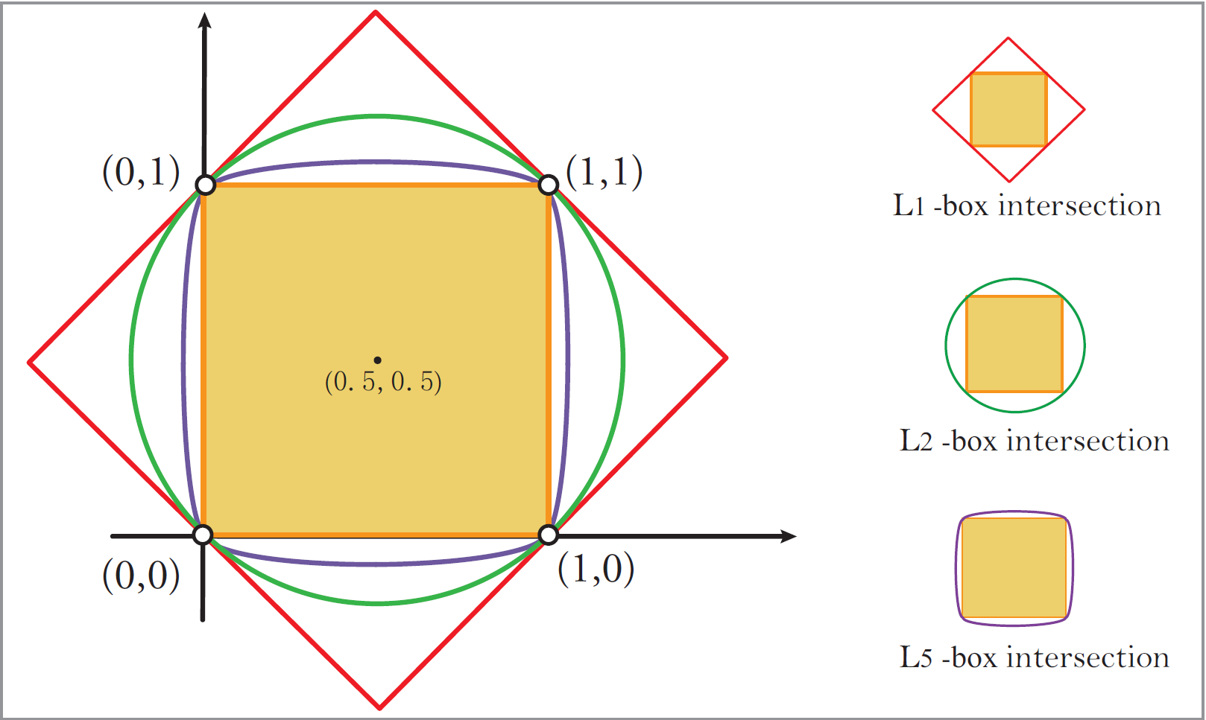
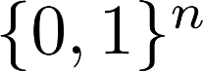
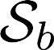
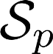
Lp-Ball and Box Equivalence to Binary

Slide 10
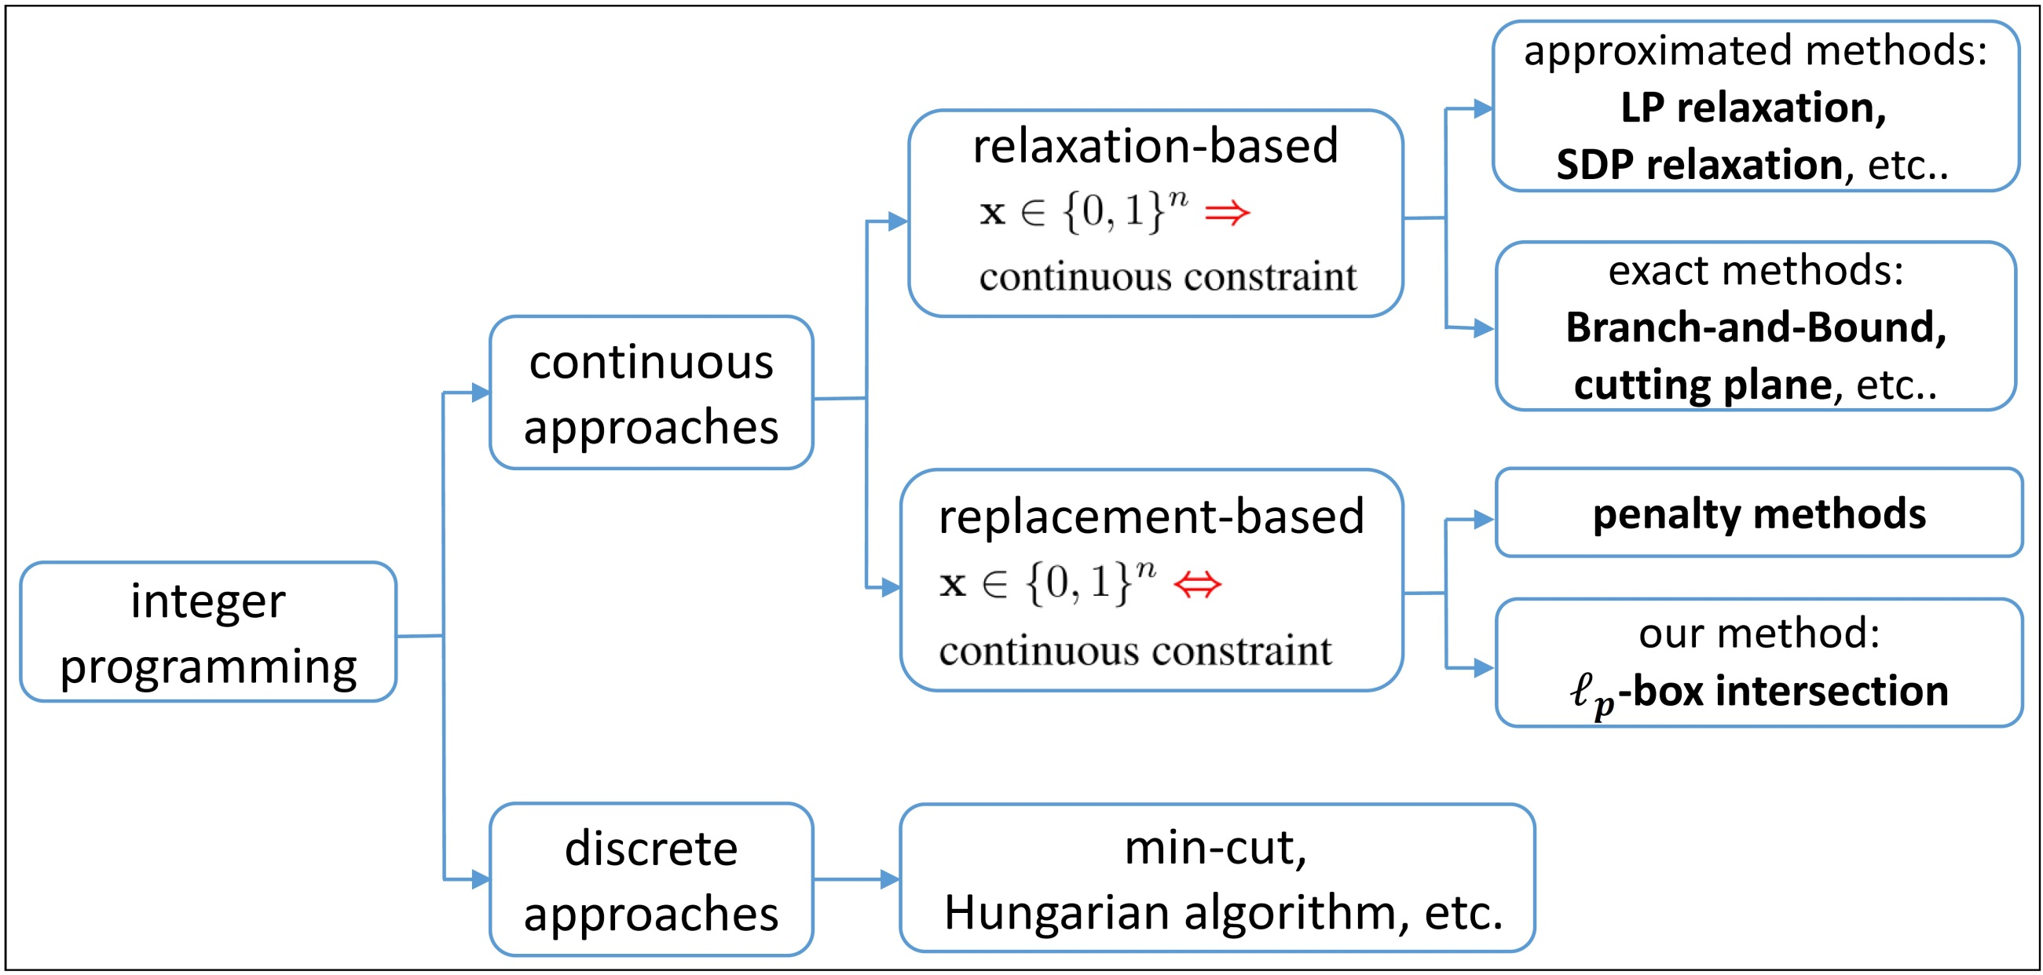
Related Work
Notes:
Continuous approaches: they solve the IP/BP in the continuous domain, i.e. the solution vector they maintain is continuous
Relaxation methods approximate the binary constraints with continuous constraints, e.g. a box only, an l2-ball only, or an SDP constraint on a lifted constraint space that squares the number of variables. If these approximations are used once, then they are approximated methods. If they are used over and over again refining the binary solution iteratively (e.g. using the penalty method or cutting plane framework), they are called exact methods.
Replacement methods replace the binary constraints with an equivalent set of continuous constraints. Most often, these equivalent constraints are added to the cost function by enforcing them incrementally using exact penalty methods, which are generic methods; however, they require the global solution to each subproblem which is in the majority of cases non-convex even if f is convex. These subproblems are therefore expensive, and their convergence proof is most cases requires that the global solution is achieved in each subproblem. Our method falls in this category of methods. As we’ll see, our method is iterative and the solution vector is not necessarily binary in each iteration. However, upon convergence, the solution that we converge to will be feasible to the original problem, i.e. binary.
Discrete approaches solve the IP/BP problem in the discrete domain directly, i.e. the solution vector is binary in each iteration. There are powerful methods in this category, e.g. min-cut/max-flow which are very famous. But, these methods only deal with specific forms of objective and cannot handle constraints. For these types of methods, I recommend that you read up on submodular functions and methods that minimize them (Francis Bach). In a nutshell, they can be considered the discrete analog of convex functions in continuous optimization.

Slide 11
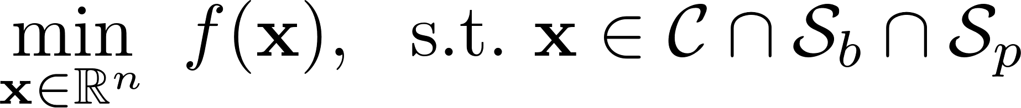
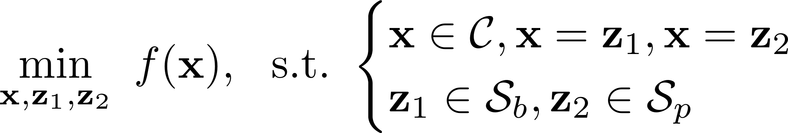
Lp-Box ADMM
1 non-convex ball constraint
n convex box constraints

Slide 12
Lp-Box ADMM
ADMM
objective
primary constraints
Lagrangian penalty terms
augmented terms

Slide 13
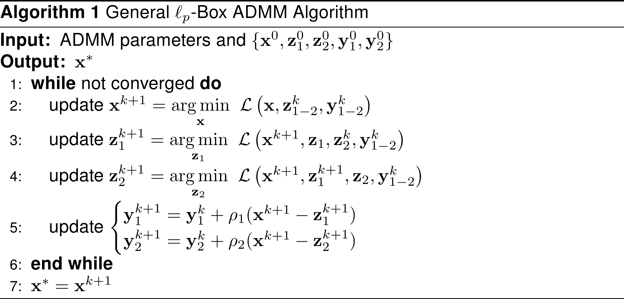
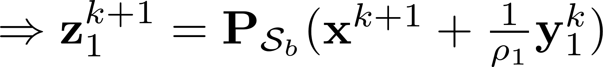
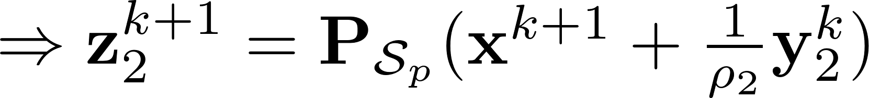
Lp-Box ADMM: General Algorithm

Slide 14
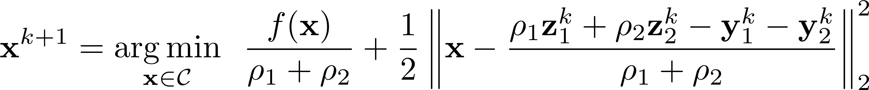
STEP2: Updating x^{k+1}
Properties:
application dependent in general

Slide 15
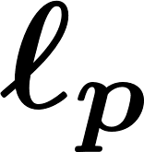
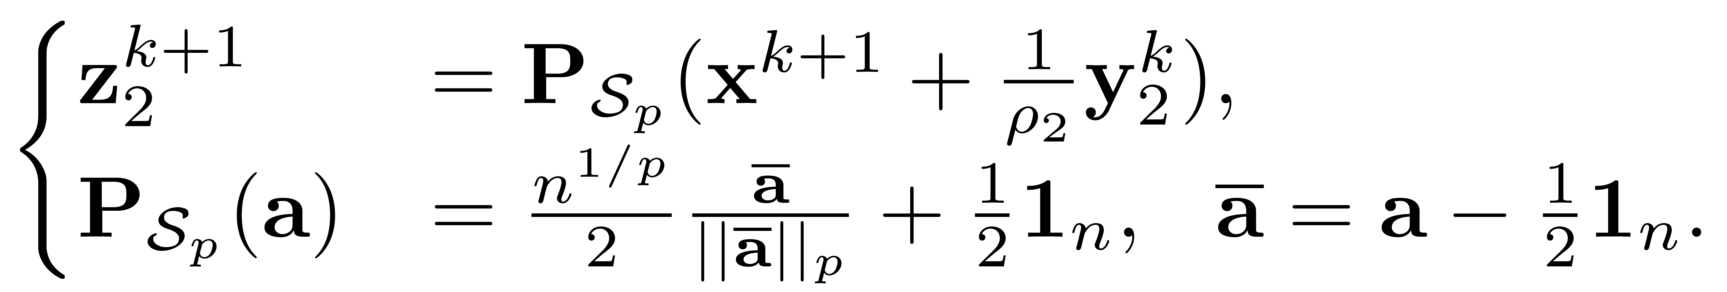
STEP4: Updating z₂^{k+1}
sphere projection
Properties:
highly dependent on p
If p=2, then solution is optimal
Which p to choose? (we will discuss later)

Slide 16
Lp-Box ADMM: Global Convergence

Slide 17
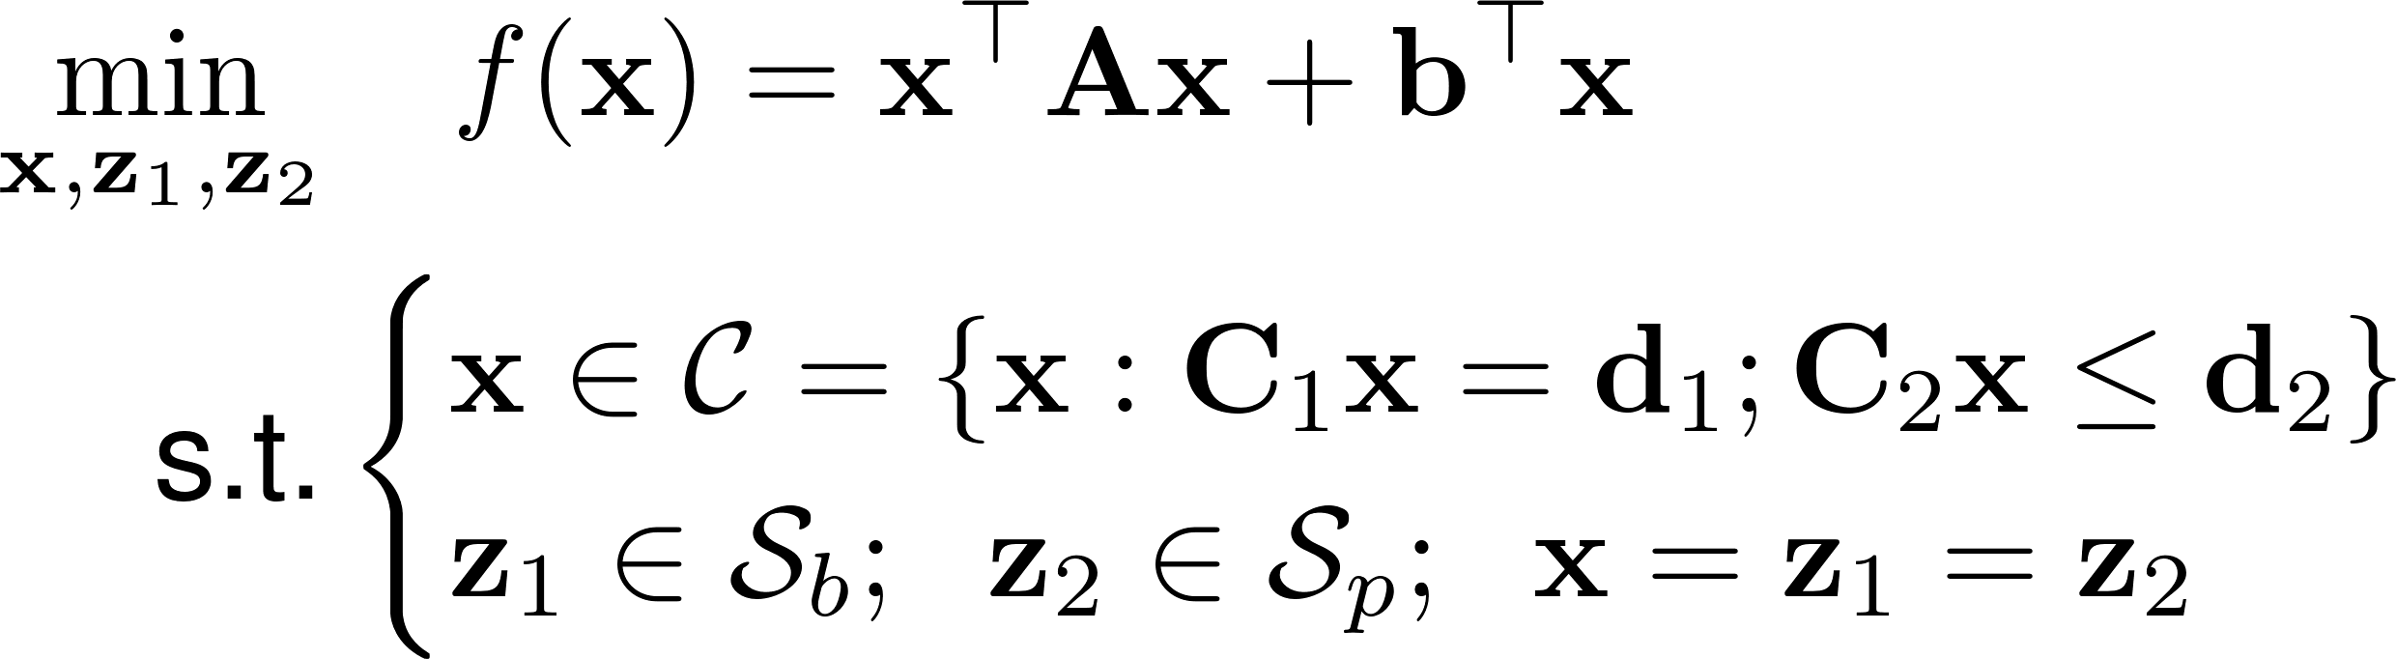
Lp-Box ADMM: BQP
This form is very popular in ML and CV (e.g. pairwise MRF, graph matching, clustering, stereo matching, etc.)

Slide 18
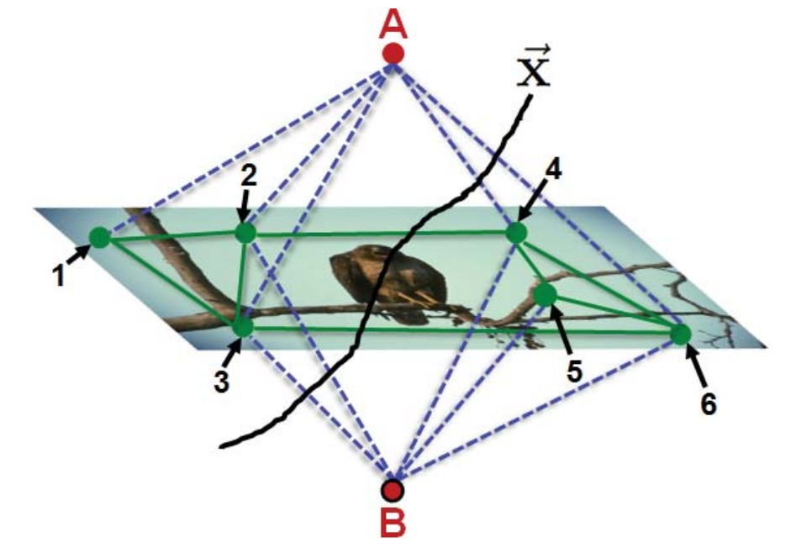
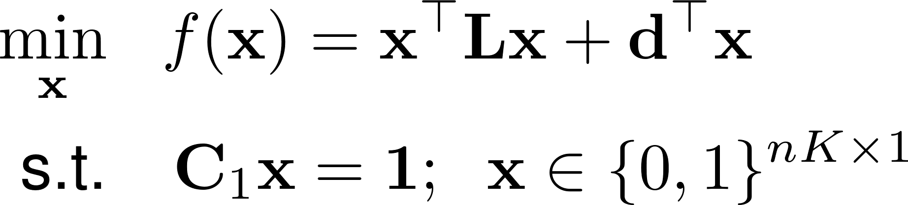
Application (1): Pairwise MRF
-- pairwise/boundary term
-- unary term

Slide 19
Application (1): Pairwise MRF

Slide 20
Application (1): Pairwise MRF

Slide 21
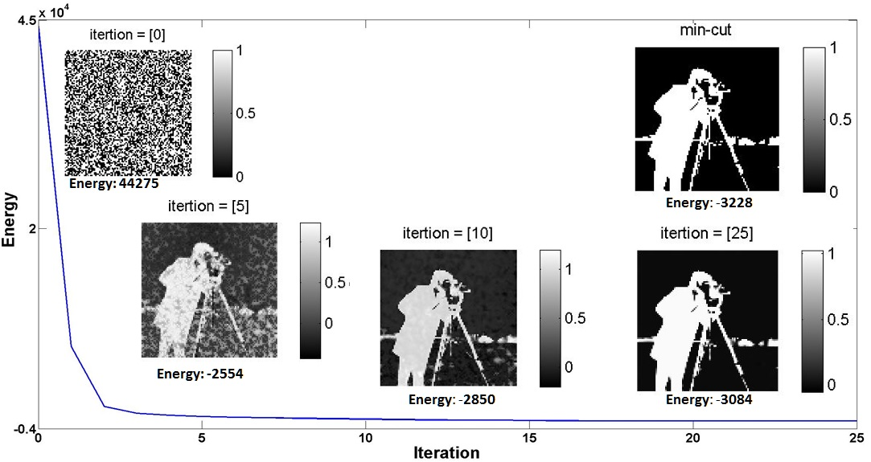
Application (1): Pairwise MRF

Slide 22

Application (1): Pairwise MRF
Ours (energy = -3215)
mincut (energy = -3228)

Slide 23
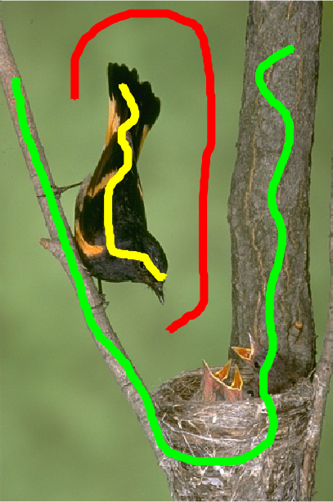
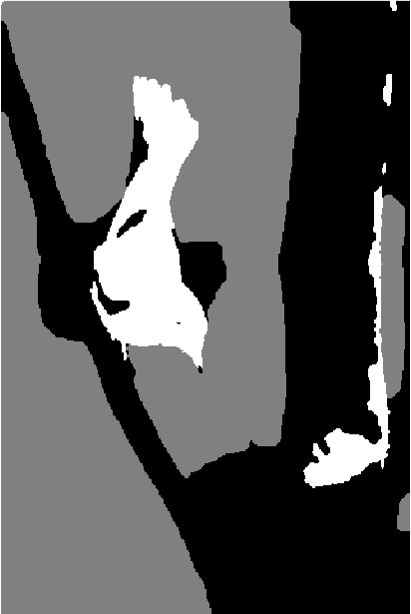
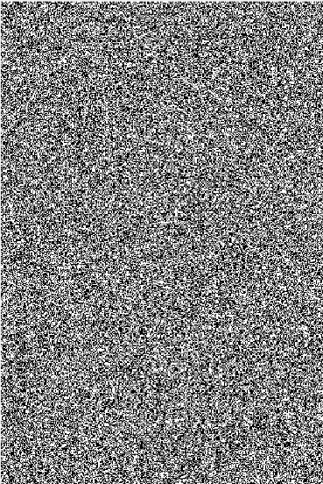
Application (1): Pairwise MRF
Original Image
mincut
Initialization
* The initialization is spatially uniform random (K=3)

Slide 24
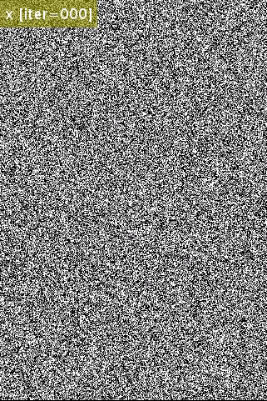
Application (1): Pairwise MRF
Original Image
mincut
Ours (per iteration)
* For each pixel (j), we show the label at which its (K=3) x_{j} components is maximum.
** Notice how x quickly and gradually converges to a local solution.

Slide 25

Application (1): Pairwise MRF
Original Image
mincut (energy = -707383)
Ours (energy = -704480)
* Notice how our solution (upon convergence) gets very close to the mincut solution

Slide 26
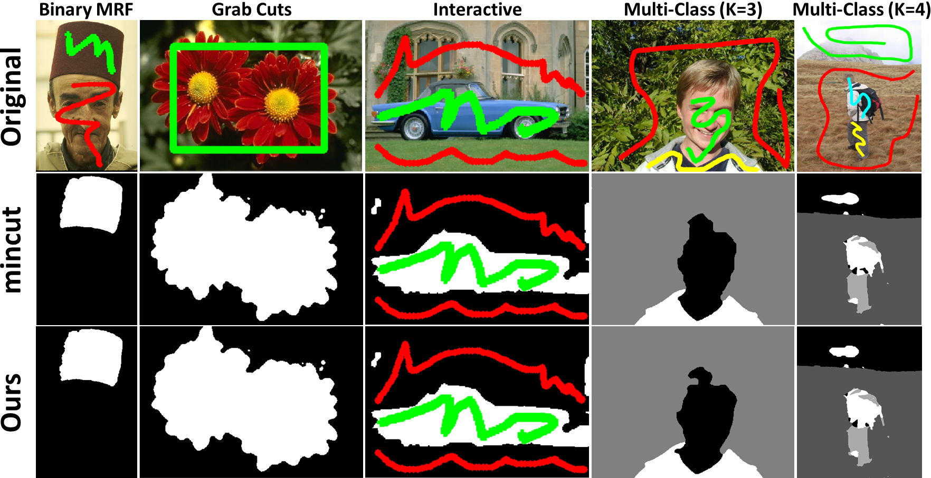
Application (1): Pairwise MRF

Slide 27
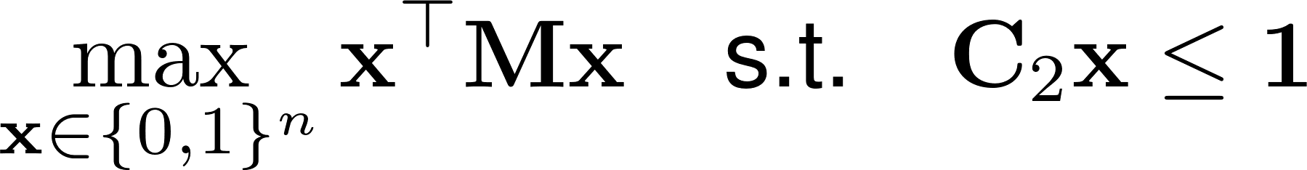
Application (2): Graph Matching
For video frame matching:

Slide 28
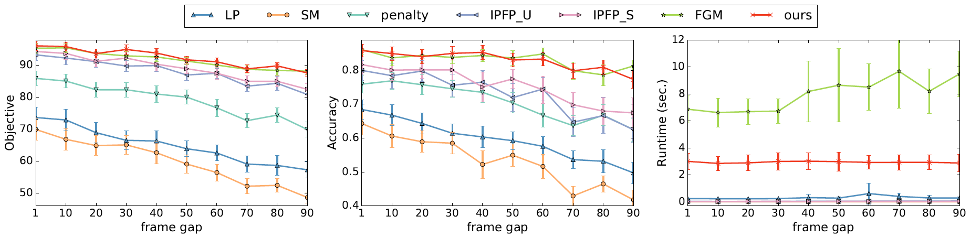
Application (2): Graph Matching

Slide 29
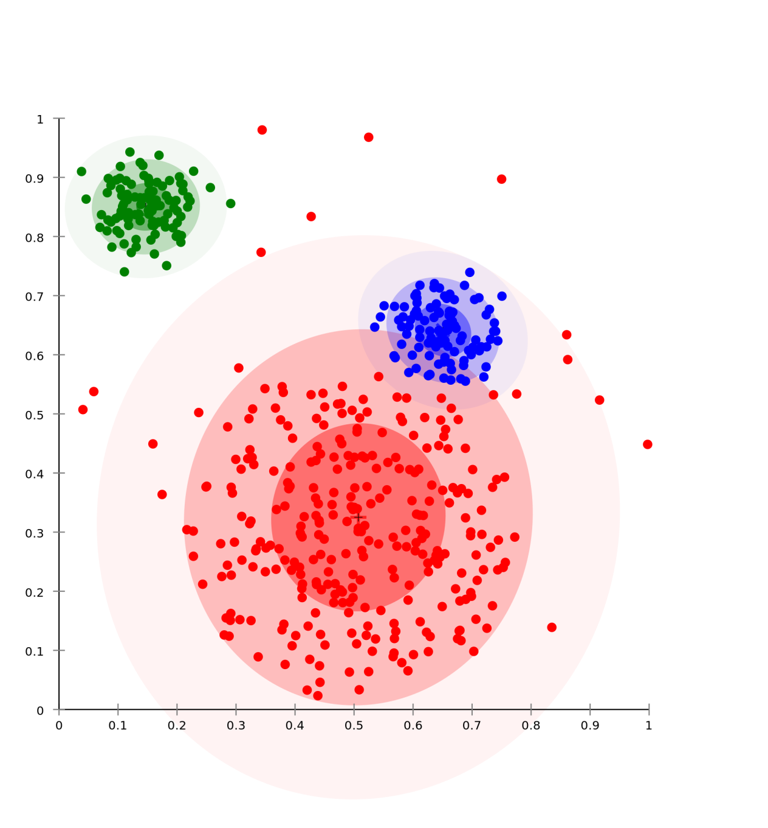
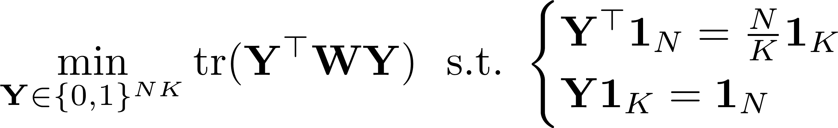
Application (3): Information Theoretic Clustering
forces clusters to
have same size
forces membership to
only one cluster

Slide 30
Application (3): Information Theoretic Clustering

Slide 31

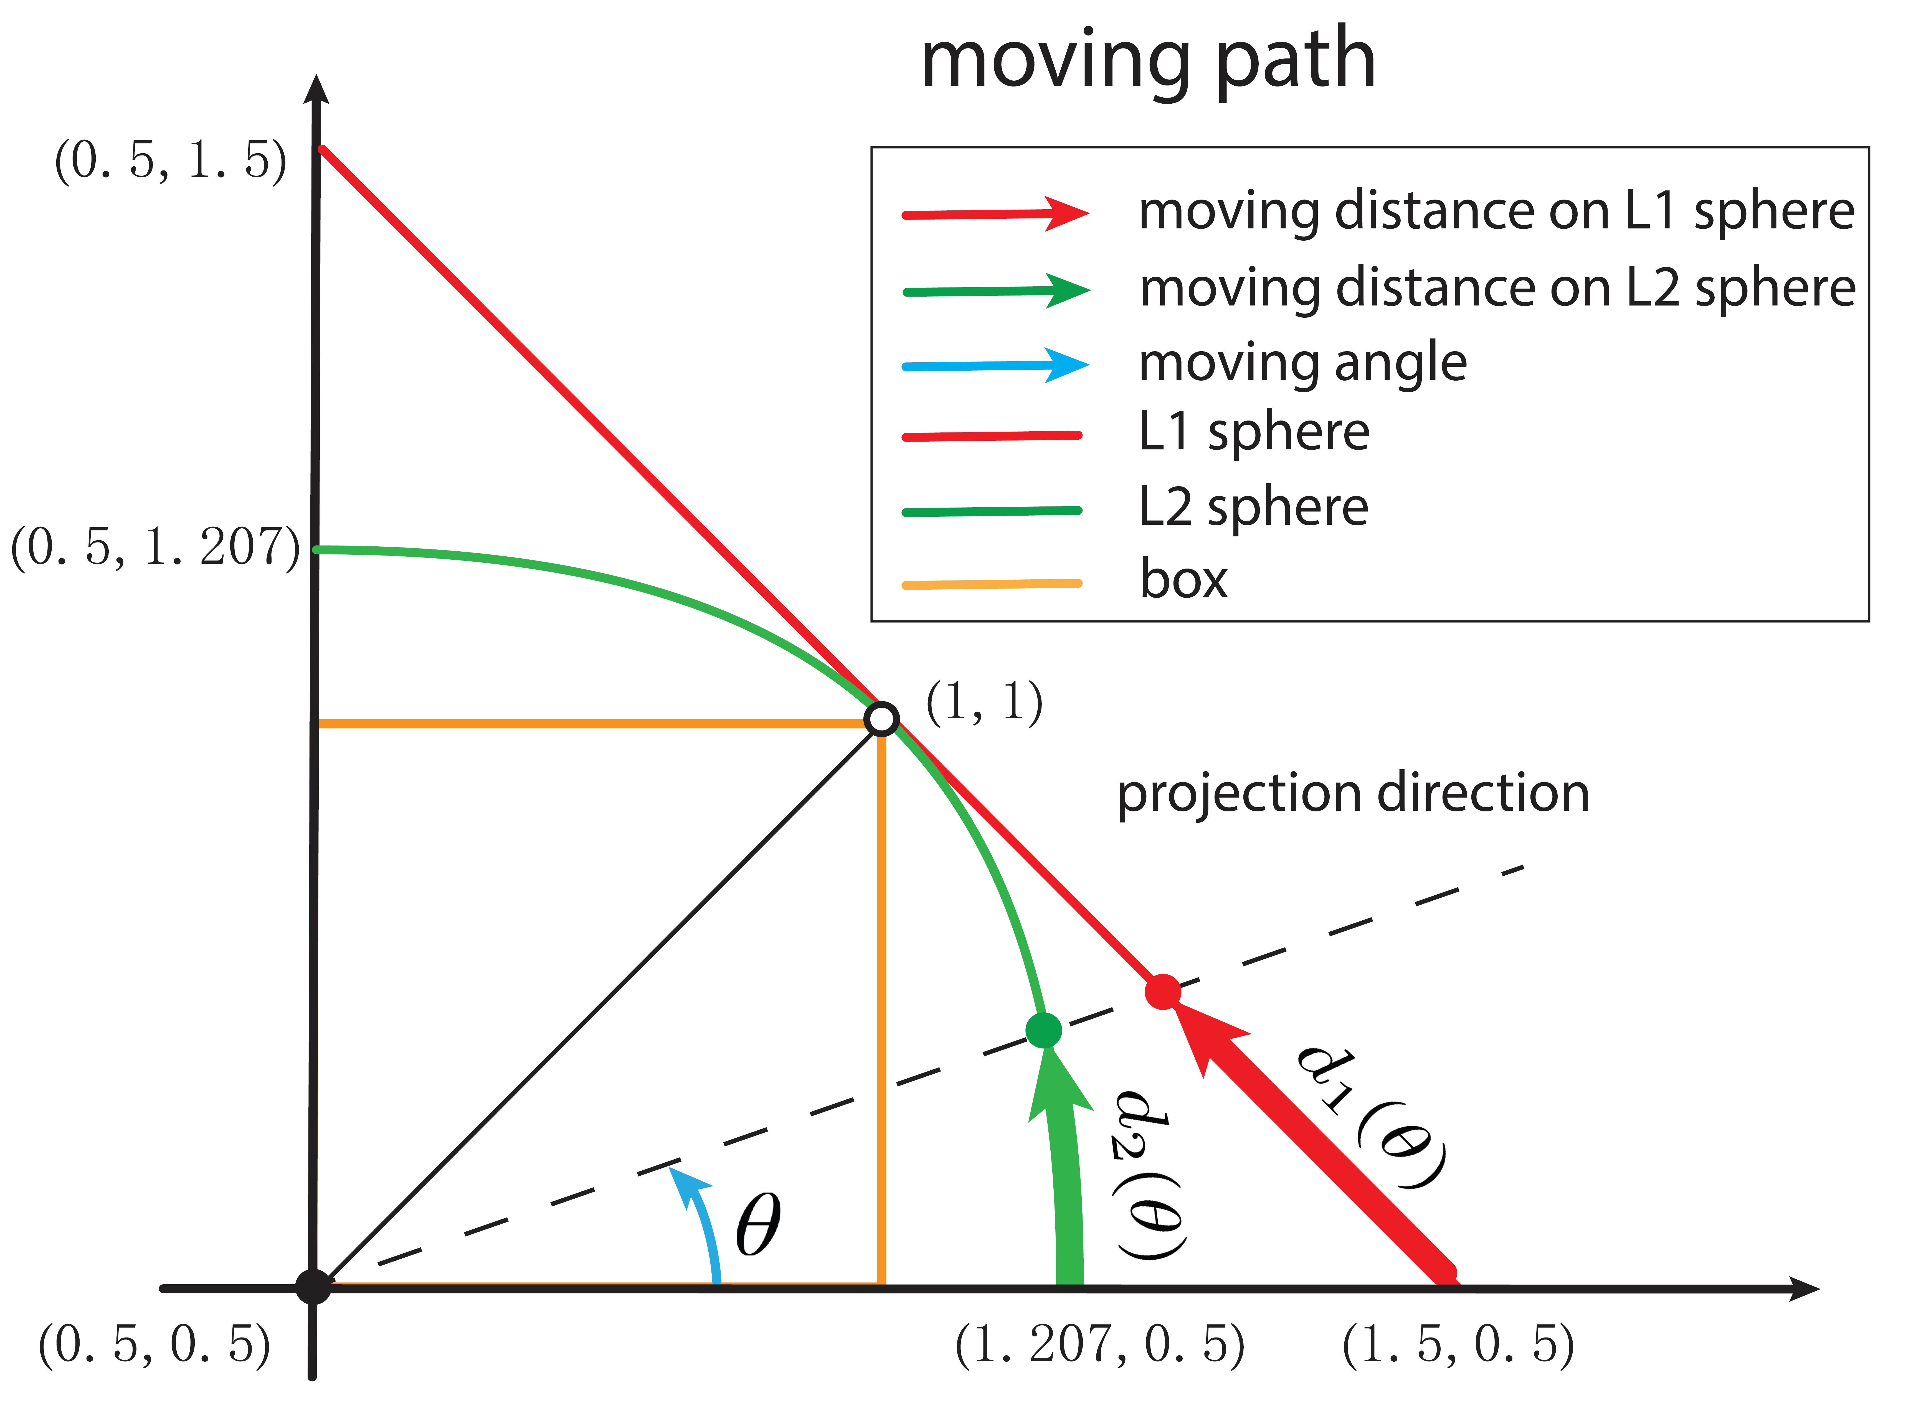
Understanding sphere projection
sphere projection

Slide 32
Understanding sphere projection

Slide 33
Understanding sphere projection

Slide 34
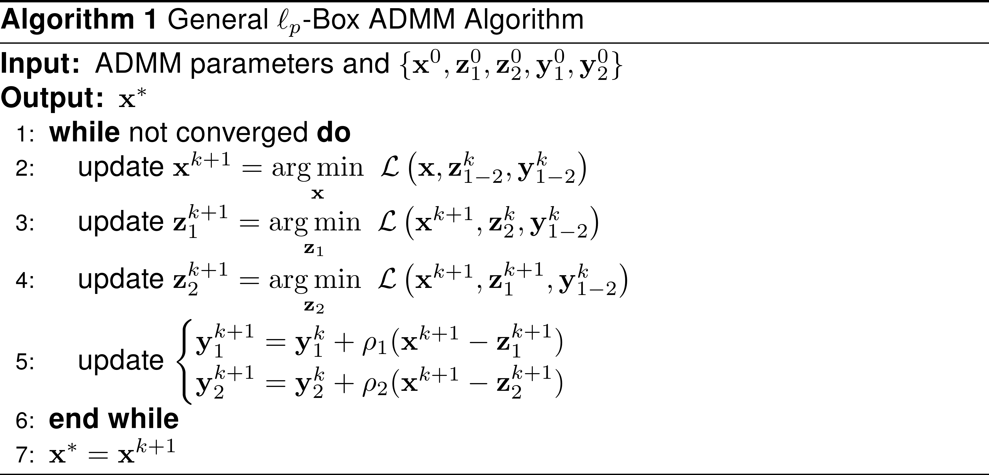
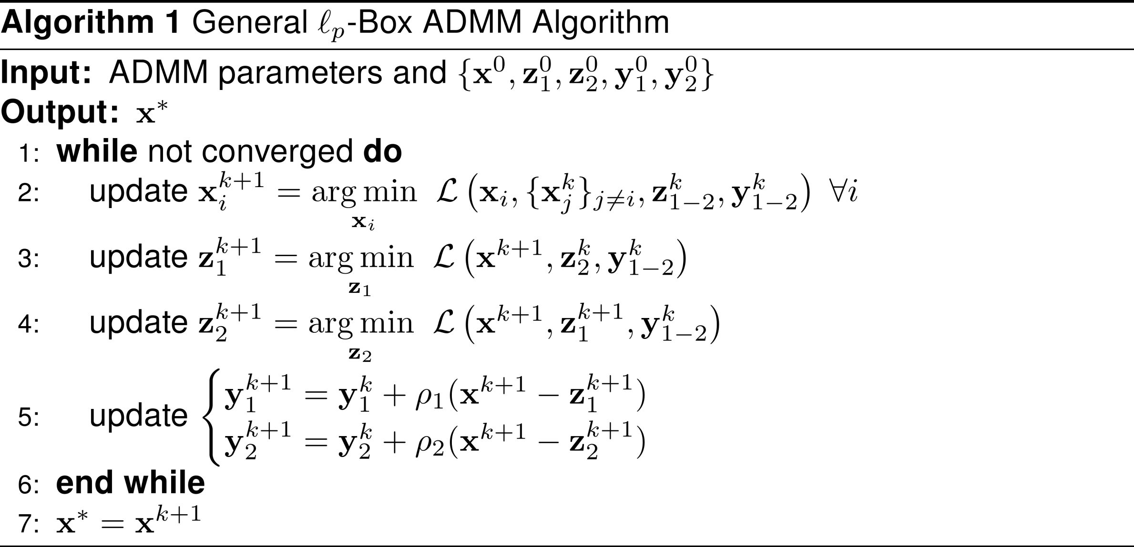
The landscape is promising!
Interesting questions to be answered:
How do we scale solution to very large problems?
Make it distributed → inexact ADMM

Slide 35
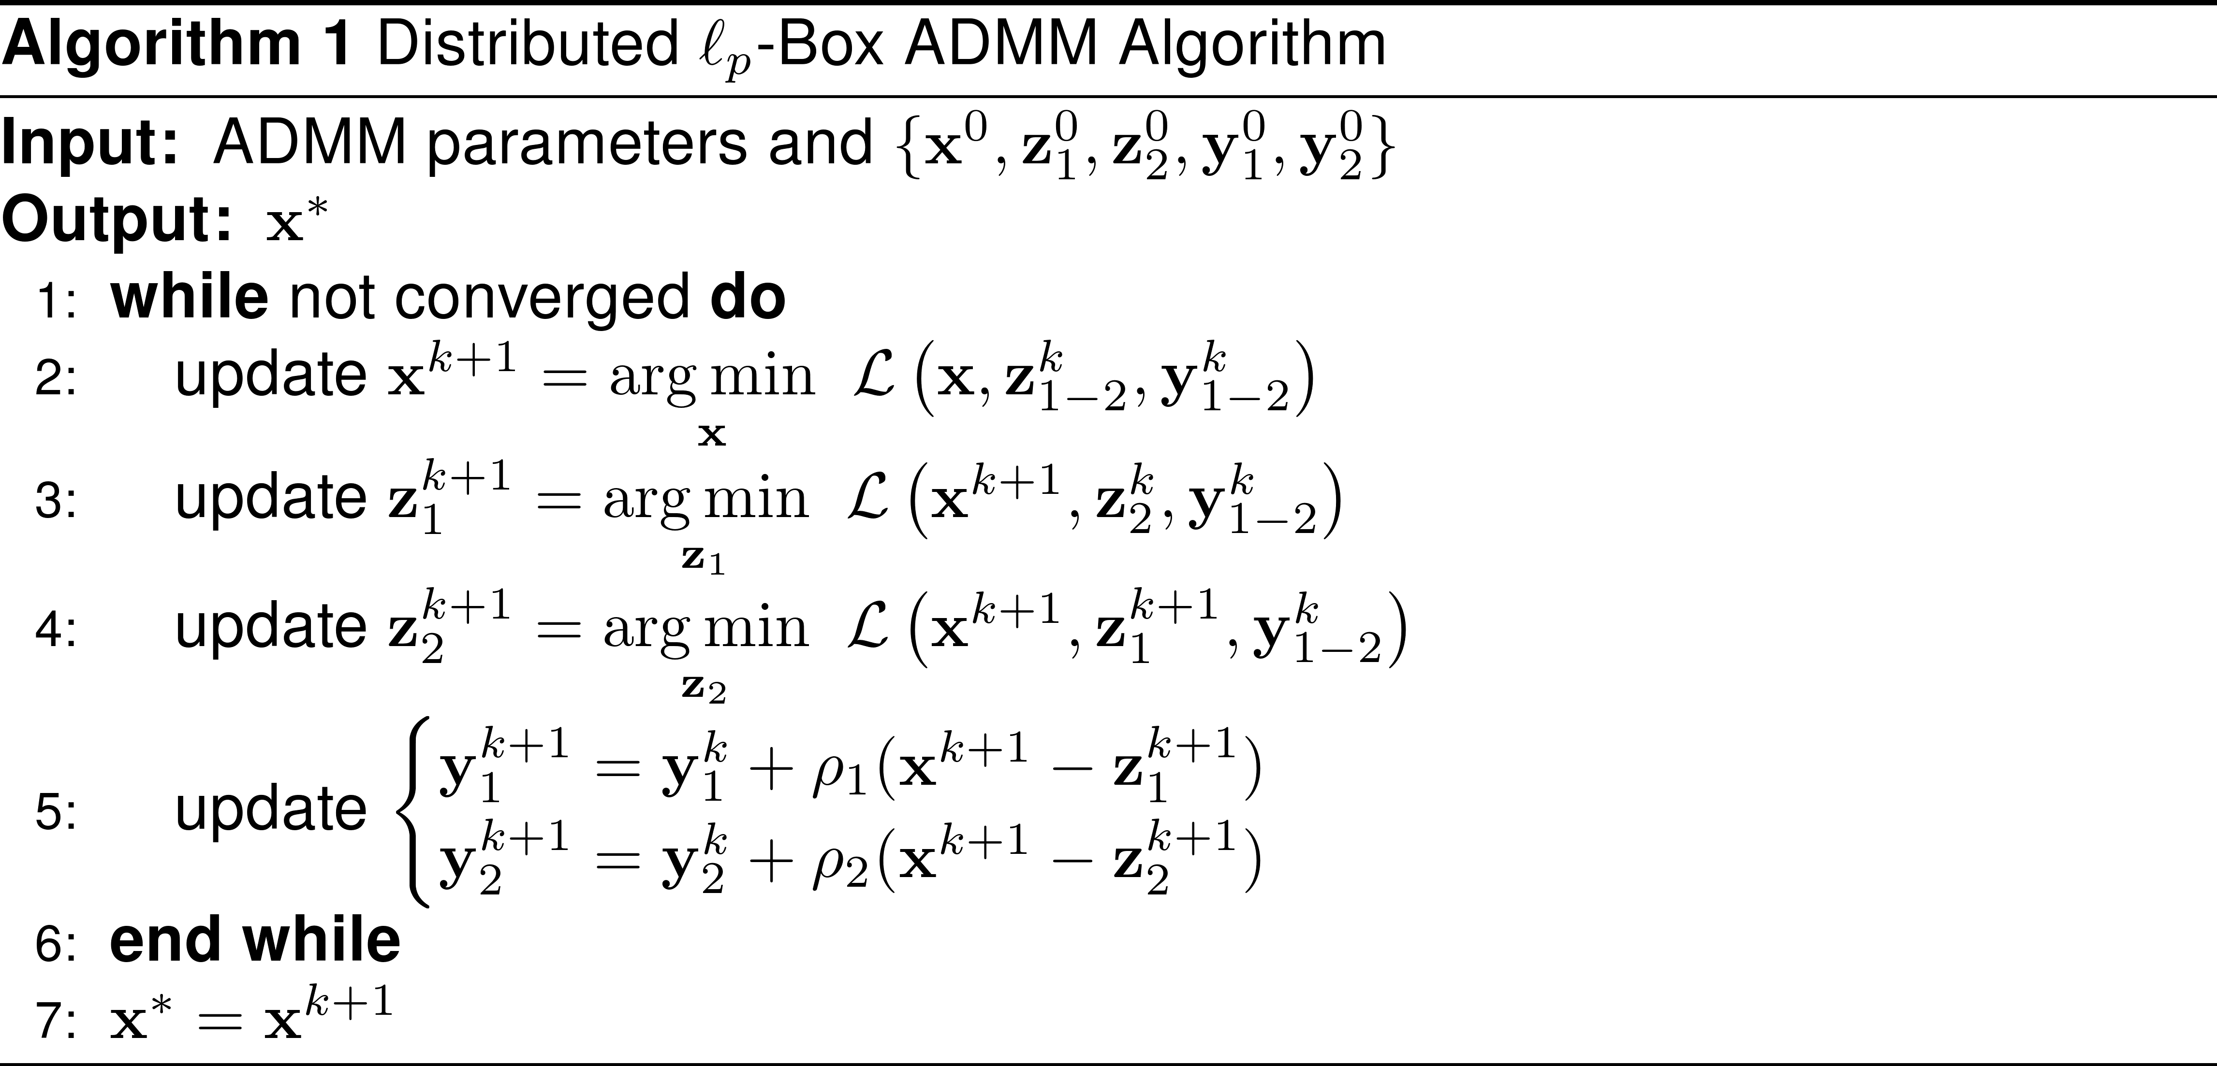
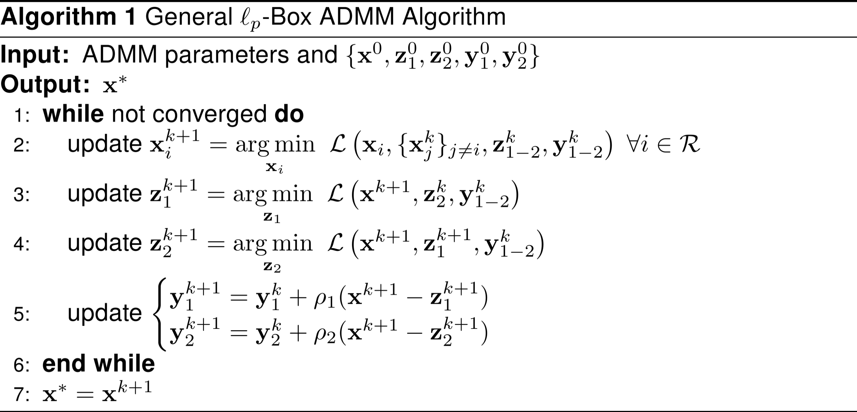
The landscape is promising!
Interesting questions to be answered:
How do we scale solution to very large problems?
Make it faster → stochastic ADMM

Slide 36
The landscape is promising!
Interesting questions to be answered:
How do we scale solution to very large problems?
Make it faster → hardware speedup

Slide 37
The landscape is promising!
Interesting questions to be answered:
What other applications can we use it in?
E.g. image restoration/denoising/deblurring
Notes:
Go beyond BQP

Slide 38
The landscape is promising!
Interesting questions to be answered:
What other applications can we use it in?
E.g. mixed integer programming
Notes:
Kmeans is an example of this

Slide 39
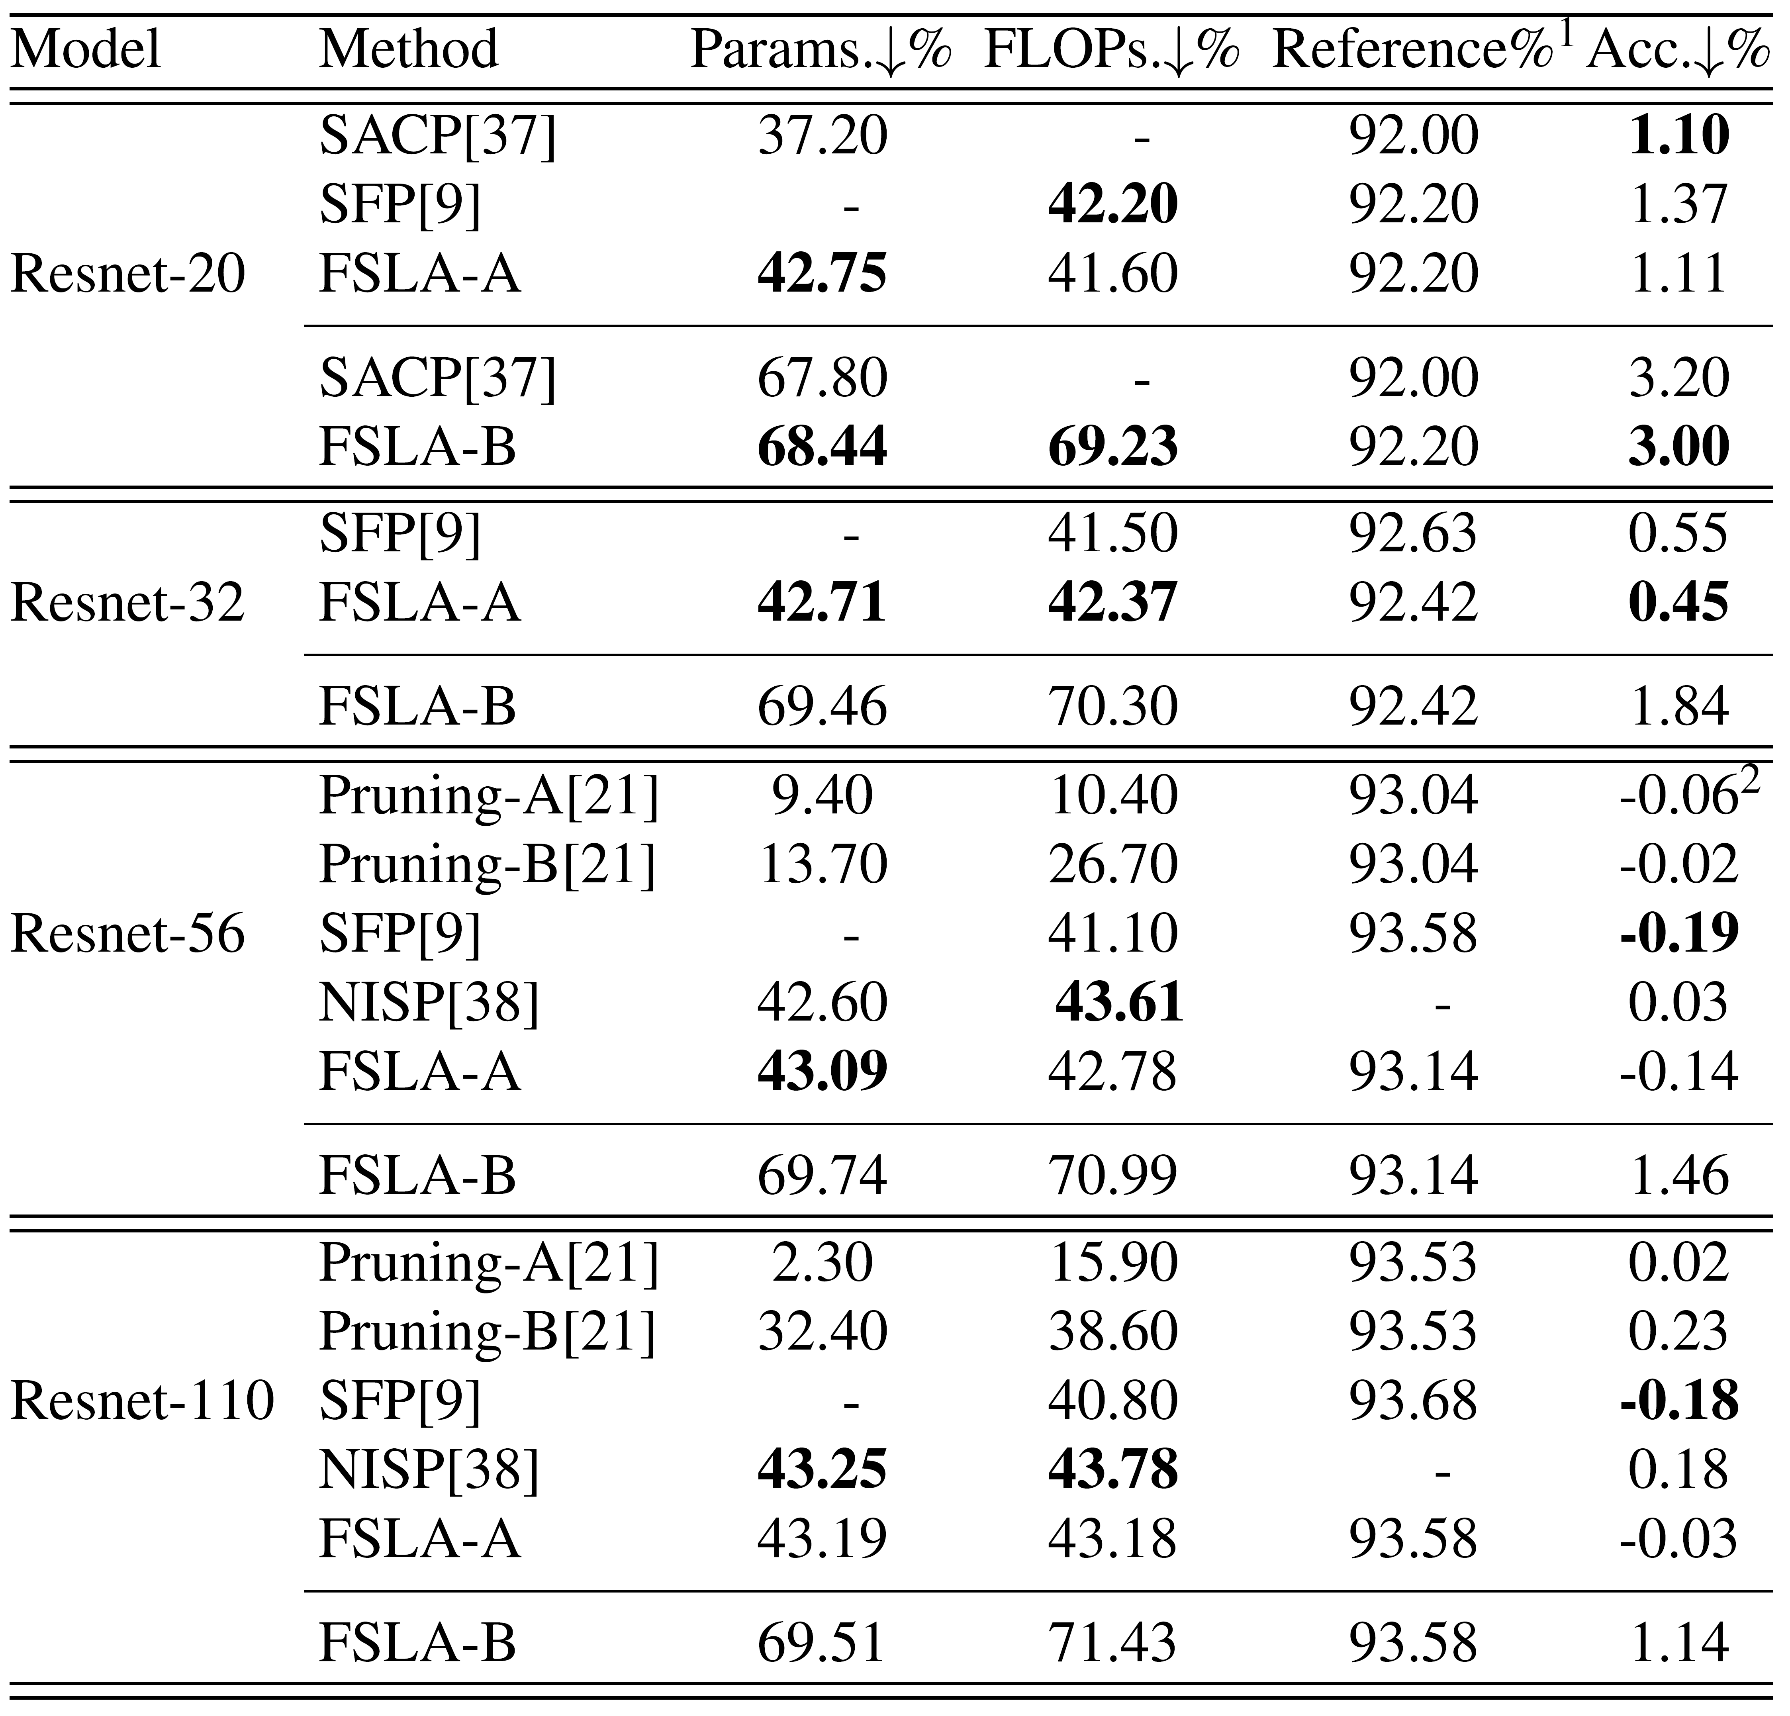
Application to model compression of CNNs
Model compression: remove some convolution filters of CNNs
We treat the filter selection and parameter training of CNNs as a joint optimization problem
It is solved by Lp-box ADMM
Notes:
Kmeans is an example of this

Slide 40
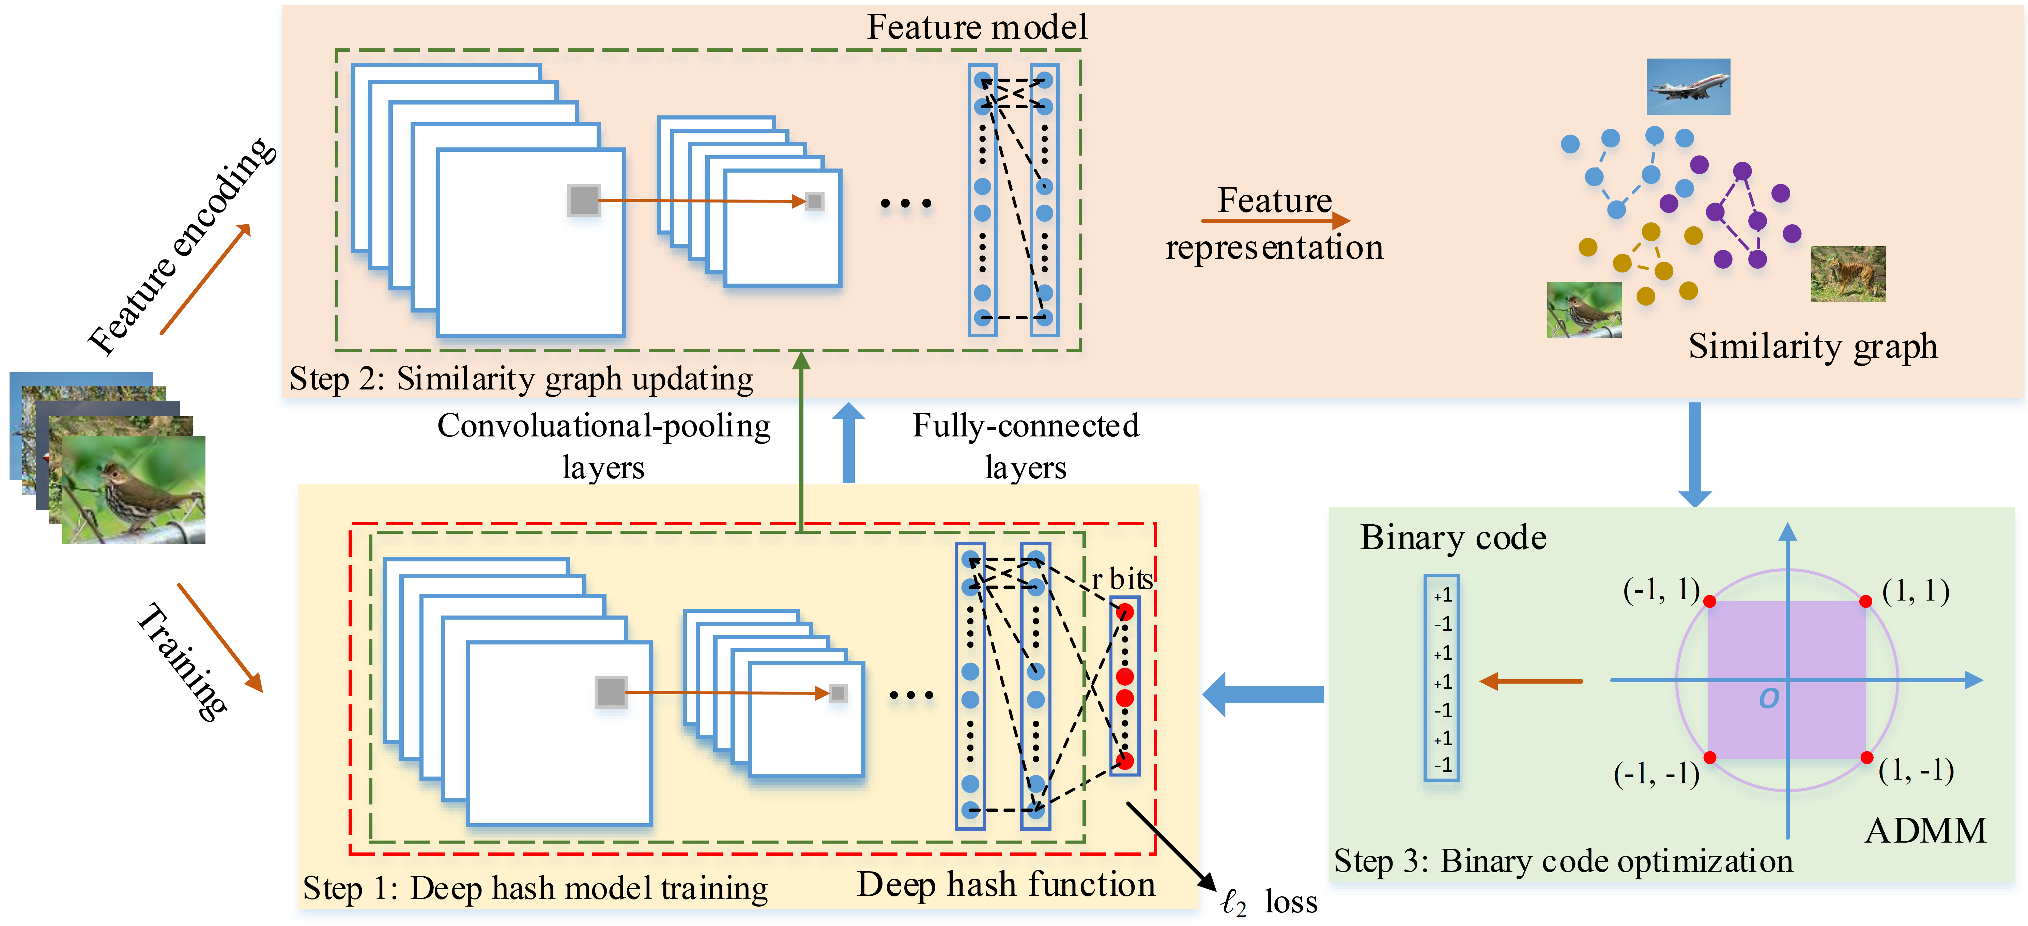
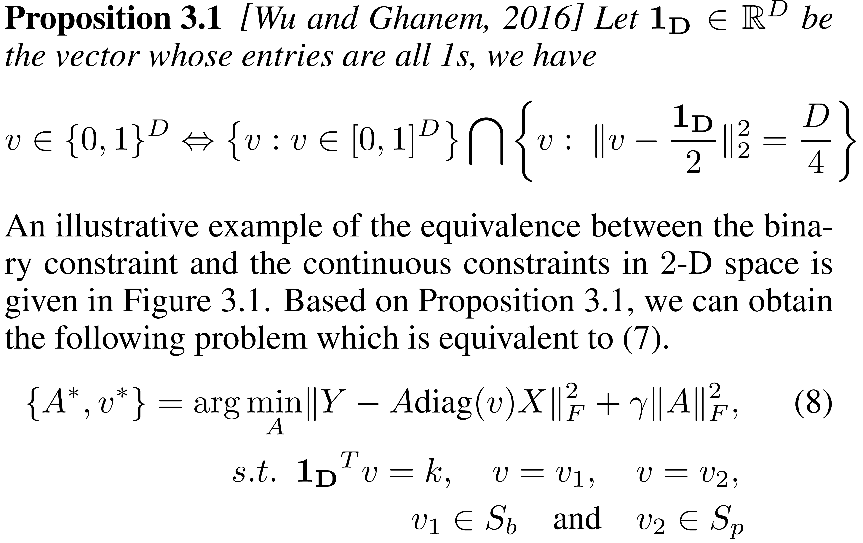
Others’ work utilizing lp-box ADMM
[1] Shen, Fumin, et al. "Unsupervised Deep Hashing with Similarity-Adaptive and Discrete Optimization." IEEE Transactions on Pattern Analysis and Machine Intelligence (2018).
[2] Fan, Mingyu, et al. "Top-k supervise feature selection via ADMM for integer programming." Proceedings of the 26th International Joint Conference on Artificial Intelligence. AAAI Press, 2017.
[3] Zhang, F., Wu, Q., Wang, H., & Shi, Y. (2017). L2-Box Optimization for Green Cloud-RAN via Network Adaptation. arXiv preprint arXiv:1711.10788.
[4] Wu, Q., Zhang, F., Wang, H., Lin, J. and Liu, Y., 2017. Parameter-free Lp-Box Decoding of LDPC Codes. arXiv preprint arXiv:1711.10767.
[1]
[2]

Slide 41
Thank You!!
Baoyuan Wu* and Bernard Ghanem*, “Lp-Box ADMM: A Versatile Framework for Integer Programming”, TPAMI 2018
Original Image
mincut
Lp-Box ADMM

